Slide 1
Communicating Climate Change to Policy Makers
This presentation is aimed to sensitize policy makers in the MMR across various facets of climate change. It takes them through the science of climate change, notes the vulnerability and impacts across various sectors in the MMR, and strategies and actions that can be implemented at the regional level.
The presentation is part of the series Climate Change related Resources and Tools (CCRT).
Conceived and Developed by :
Environmental Management Centre LLP for Mumbai Metropolitan Region – Environment Improvement Society

Slide 2
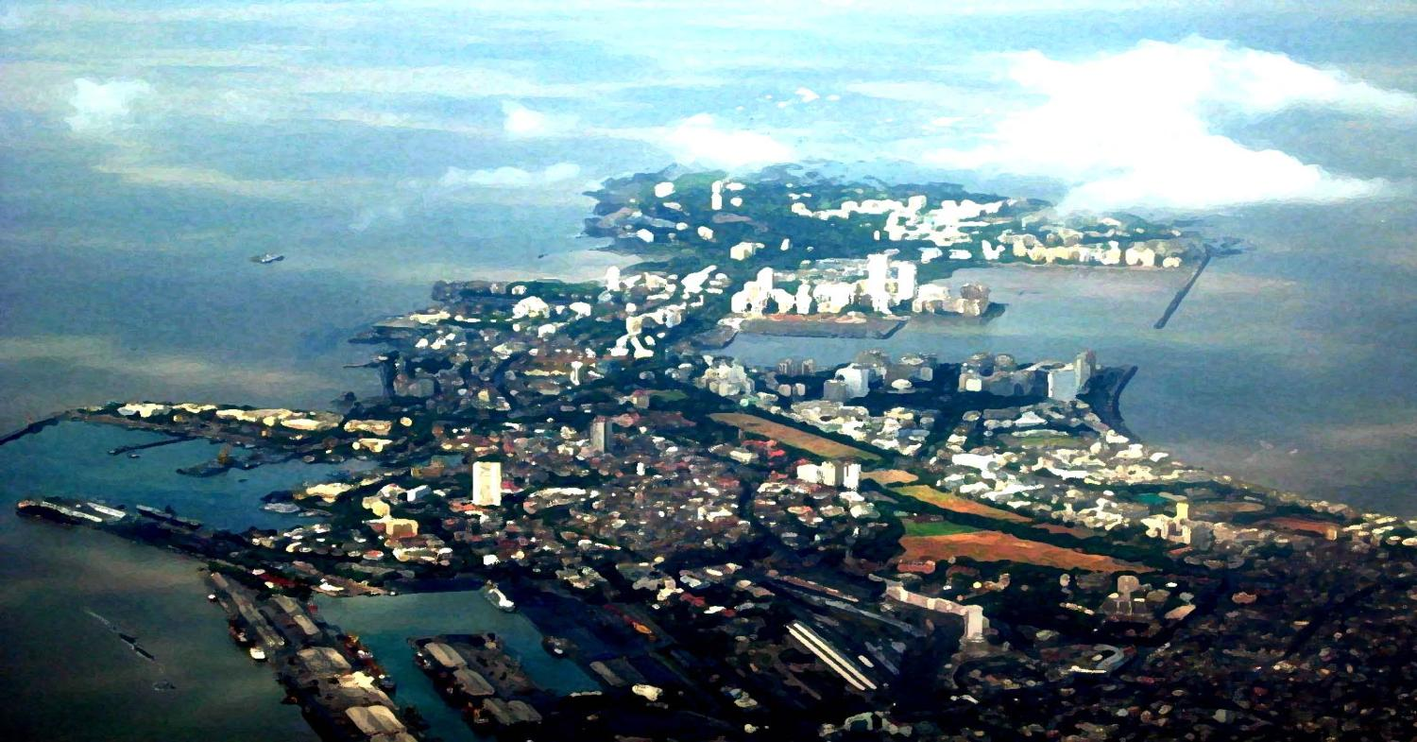
Communicating Climate Change to Policy Makers
Prepared By: Environmental Management Centre LLP, Mumbai

Slide 3
Global Warming
By travelling
By using electricity
By running industries
Earth requires greenhouse gases so that living beings can survive
We add more greenhouse gases every day
(CO₂, CH₄, NO_{X})
SUN
BUT
Sunlight
Reflected sunlight
Radiated back to space
Leading to
SO
Absorption by land and water
Heat trapped by greenhouse gases
More heat is trapped
EARTH
GLOBAL WARMING
Notes:
The atmosphere has a natural supply of "greenhouse gases." They capture heat and keep the surface of the Earth warm enough for us to live on. Without the greenhouse effect, the planet would be an uninhabitable, frozen wasteland.
Before the Industrial Revolution, the amount of carbon dioxide (CO₂) and other greenhouse gases released into the atmosphere was in a rough balance with what was absorbed in natural sinks. For example, plants take in CO₂ when they grow in spring and summer, and release it back to the atmosphere when they decay and die in fall and winter.
Industry took off in the mid-1700s, and people started emitting large amounts of greenhouse gases. Fossil fuels were burned more and more to run our cars, trucks, factories, planes and power plants, adding to the natural supply of greenhouse gases. The gases—which can stay in the atmosphere for centuries—are building up in the Earth’s atmosphere and, in effect, creating an extra-thick heat blanket around the Earth.
The result is that the globe has heated up by about one degree Fahrenheit over the past century—and it has heated up more intensely over the past two decades.
Today, people have increased by nearly 40 percent the amount of CO₂, the chief global warming pollutant, compared to pre-industrial levels

Slide 4
Effects of global warming
Impacts on MMR
Change in Living conditions of plants and animals
Habitat loss and extinction
Change in Living conditions of plants and animals
Habitat loss and extinction
Change in Seasons
Change in migration patterns
Droughts and wild fires in some places
Change in migration patterns
Increased evaporation
Global warming
Melting of glaciers,
snow caps
Increased Rains in some places
Increased absorption of energy by Earth
Increased Rains in some places
Warmer Oceans
Increased storms
Sea Level Rise
Increased storms
Sea Level Rise
Adapted from: http://epa.gov/climatechange/kids/basics/concepts.html
Notes:
Rising global temperatures lead to other changes , such as stronger hurricanes, melting glaciers, and the loss of wildlife habitats. That's because the Earth's air, water, and land are all related to one another and to the climate. This means a change in one place can lead to other changes somewhere else. For example, when air temperatures rise, the oceans absorb more heat from the atmosphere and become warmer. Warmer oceans, in turn, can cause stronger storms.
Since the 1970s, droughts have become longer and more extreme worldwide, particularly in the tropics and subtropics.
As temperatures rise and the air becomes warmer, more moisture evaporates from land and water into the atmosphere. More moisture in the air generally means we can expect more rain and snow (called precipitation) and more heavy downpours. But this extra precipitation is not spread evenly around the globe, and some places might actually get less precipitation than they used to get. That's because climate change causes shifts in air and ocean currents, which can change weather patterns
Hurricanes and other tropical storms get their energy from warm ocean water. As the top layer of the ocean gets warmer, hurricanes and other tropical storms grow stronger, with faster winds and heavier rain. Because of higher temperatures and increased evaporation, climate change causes other types of storms to get stronger, too.
As water gets warmer, it takes up more space. Each drop of water only expands by a little bit, but when you multiply this expansion over the entire depth of the ocean, it all adds up and causes sea level to rise. Sea level is also rising because melting glaciers and ice sheets are adding more water to the oceans.

Slide 5
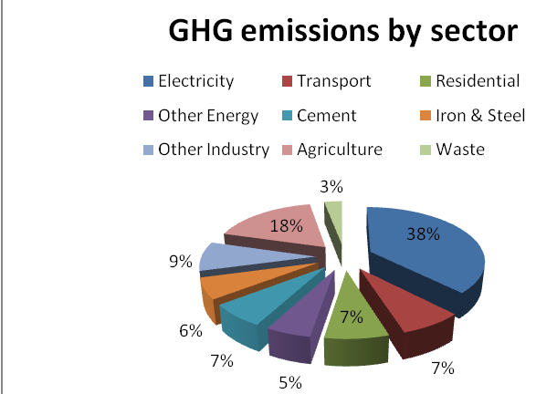
GHG emissions - India
Year
CO₂ emissions
1994
1.2 billion tonnes CO₂
2007
1.7 billion tonnes CO₂
Source: INCCA (2010), India: greenhouse gas emissions 2007, Ministry of Environment and Forests, GOI, New Delhi

Slide 6
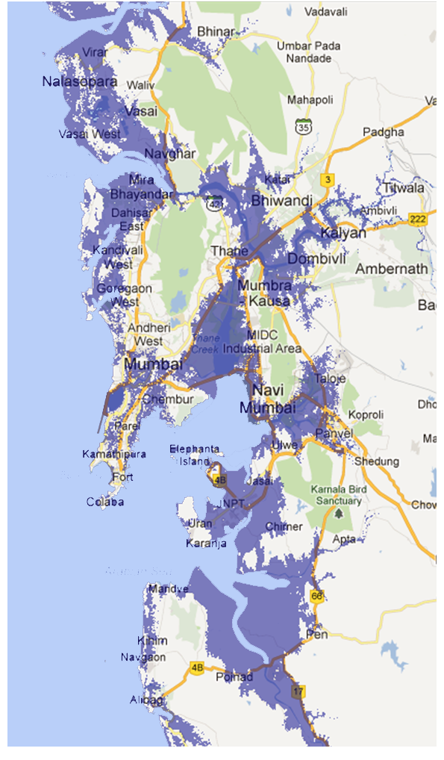
Climate change and MMR
Low Elevation Coastal Zone (LECZ) – 10m
Sea Level Rise
Increased Storm Surges
Increased precipitation
Impacts on health
Indian sea level rise of 1.3 mm/ year in last 100 years¹
1m sea level rise will inundate 41000 Ha (0.13%) of land in Maharashtra ³
MMR -3rd most Vulnerable in India⁴
46% population in Greater Mumbai resides in low elevation coastal zones (LECZ).²
Increase in storm surges & cyclones in Arabian Sea ¹
Surges combined with extreme precipitation - likely event in future²
High risk zones : Mumbai, parts of Thane & Alibaug
Likely Impacts: Coastal Erosion- villages, commercial establishments along coastline, marine habitats & fisheries
Increase in rainfall by 6 to 8 %, i.e.69 to 109 mm by 2030¹
Decrease in rainfall intensity
& nos. of rainy days -Western Ghats¹.
- High intensity rainfall in short time span: torrential rains & flash floods.
Temperature rise : 1.7 -1.8°C in 2030 wrt 1970.¹
Increase in heat waves-summer
Increase in vector borne diseases-monsoons.
2% of total malaria cases in India are from Maharashtra. ²
The trend will increase
Heat stroke, diarrhea cases increase due to increased humidity ¹
Source: ¹ A.S. Unnikrishnan, M.Manimurali and M.R. Ramesh Kumar National Institute of Oceanography, Goa(2007)
²Dasgupta, S. et. al. (2007). The Impact of Sea Level Rise on Developing Countries: A Comparative Analysis, World Bank Policy Research Working Paper 4136, February 2007
³ TERI (1996), The Economic Impact of a One Meter Sea Level Rise on the Indian Coastline: Method and Case Studies. Report submitted to the Ford Foundation, Tata Energy Research Institute. New Delhi.
⁴ http://www.envfor.nic.in/news/janmar06/sea_level.pdf
Source: ¹ Tyagi. A, (2010), IMD Pune, Climate Profile of India
² IPCC (2007), The physical science Basis
Source: ¹ INCCA (2010), Climate Change and India: A 4×4 report assessment, Ministry of Environment and Forests
Note: Industrial zones
(approx. area) overlaid on 10m elevation zones (LECZ)
Source: ¹ INCCA (2010), Climate Change and India: A 4×4 report assessment, Ministry of Environment and Forests
² http://envis.maharashtra.gov.in/envis_data/newsletter/climatechange/Links/cc_and_mah.html
Notes:
Even if Mumbai is the most important city in India, with its larger area located on a flood prone, poorly drained, composed largely on landfill, Mumbai is highly vulnerable to the climate hazards as shown by the large scale flooding during 2005. The most vulnerable are those 54% people living in slums, many of which are located in low-lying areas without adequate sanitation and water supplies. Further, much of the new settlements has occurred along the coastal areas of greater Mumbai, which are low lying and flood plain. Mumbai’s climate is tropical; with temperature ranging between 16 degree C and 33 degree C. Mumbai is vulnerable to inland flooding during the monsoon seasons, sea-level rise, coastal flooding and various health risks like malaria. Climate change is expected to exacerbate the current problems. Flooding is the most important problem for Mumbai. When heavy rains combine with high tide surges or storm surges, most landfills areas in Mumbai are prone to flooding. However, the most vulnerable people due to flooding are the people living in slums and low lying areas. Populations densities for roughly one-half of Mumbai’s squatter communities are estimated to be as high as 94,000 people per square kilometer, making it one of the most densely settled districts in the world (Sherbini et al, 2009). Apart from inland flooding Mumbai is highly vulnerable to the impact of sea-level rise (TERI, 1996). As can be seen from the first table 46% of people are living in the low elevation coastal zones. According to one of the study (Dasgupta et al 2007) up to one percent of India’s urban areas could be inundated by three meter sea level rise. India was estimated to have the second largest populations located in the LECZ of 63 million and seventh in terms of areas i.e. 82,000 sq.km or about three percent of national geographic areas at risk (Mc Granahn, 2007). The Canadian centre for A2 and B2 scenarios predict an average annual temperature increase of 1.7500C and 1.2500C respectively by 2050. Mumbai is predicted to have an average annual decrease in precipitation of two percent for A2 and an increase of two percent for B2 scenario. The sea-level rise is predicted to increase by 50 centimeters by 2050. Further, a study by TERI put the cost to Mumbai of one meter sea level rise at US$ 71 billion dollar. The study concluded that US$24 billion invested in protection against sea-level rise would reduce the economic impact by US$ 33 billion dollars (TERI, 1996).
http://theindiaeconomyreview.org/Article.aspx?aid=30&mid=3

Slide 7
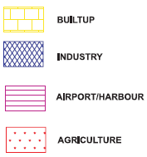
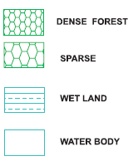
Climate change and MMR
Impacts on agriculture
Impacts on fisheries
Impacts on forests & wildlife
Area under Agriculture MMR – 1850 sq.km¹
Increase in Yield
Coconut : 30%²
Decrease in Yield:
Rice :20% ²
Rain fed Maize : 15-50% ²
Sugarcane :25-30%. ³
50,000 livelihoods -Fishing.³
Fish distribution & migration pattern will change due to rise in temperature¹
Decline in the number of Red snappers (Tambi), Eels, Sting rays, Mudskippers.²
Sea level rise – decrease in cover of mangroves
Changes in temperature, humidity & rainfall – impact flora, living conditions & migratory pattern of fauna.
18% of Western Ghats to undergo changes till 2030¹
Change will increase in net primary productivity and loss of biodiversity
Source: ¹ INCCA (2010), Climate Change and India: A 4×4 report assessment, Ministry of Environment and Forests
² Salagrama V, (2012)Climate Change and Fisheries: Perspectives from Small-scale Fishing Communities in India on Measures to Protect Life and Livelihood, ICSF
³Pagdhare P, Bhakay J. (2012), Financial understanding of fishermen in Mumbai and Palghar area, Zenith Journal, vol.2, issue 3
Source: ¹ Murthy R, Rao R, Inamdar A,(2001) Integrated coastal management of Mumbai Metropolitan Region, CSRE, IIT-B,
² INCCA (2010), Climate Change and India: A 4×4 report assessment, Ministry of Environment and Forests
³ World Bank(2009), Climate change Impacts in drought and flood affected areas

Slide 8
Initiatives by Indian Government
Key Initiatives
National Action Plan on Climate Change
Establishment of Prime Ministers Council for Climate Change
Guidelines for Preparation of State Climate Action Plan
Forests
Programme for Conservation, Regeneration & Mgmt of Existing Forests & Wildlife.
Capacity Building of Frontline Forest Staff
Improving forest infrastructure- Rs. 8,300 Cr
Afforestation: Increase Forest Cover - 0.8 million hectares/year-Neutralizing 11% annual GHG emissions.
Inclusion of Forestry activities under NREGA
Energy efficiency
Reducing energy intensity–From 0.30 (1980) to 0.16 kgoe per $ GDP in PPP terms
Fuel Efficiency Norms
Energy Conservation Building Code (ECBC)
Energy Efficiency Standards for Appliances
National Solar Mission setting ambitious solar energy generation targets for the medium-term.
Active participation in Clean Development Mechanism (CDM))
Source: India: taking on climate change ,Twenty Recent Initiatives Related to Climate Change, 1st Sept, 2009, MoEF

Slide 9
Initiatives by Indian Government
Research programs
Comprehensive scientific climate change programme Involving 120 Research Institutions & 220 Scientists
Launching satellite to monitor GHG in atmosphere
Impact Assessment on Climate Change
Himalayan Glacier Monitoring Program
India’s Forests and Tree Cover
India’s Carbon Emissions
Outreach
Public & Media Campaigns : Stakeholder Meetings with Industries, Media, Policy Makers, etc.
Release of India’s Submissions to UNFCCC
Key Events
SAARC CDM Conclave
India’s Carbon Market Conclave
SAARC Environment Ministries Conference
Conference on, ‘ Climate Change, Technology Development & Transfer
Source: India: taking on climate change ,Twenty Recent Initiatives Related to Climate Change, 1st Sept, 2009, MoEF

Slide 10
Strategies for Climate Resilient City

Slide 11
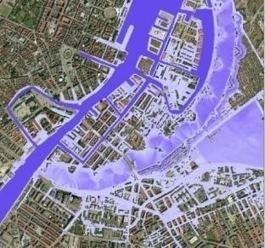
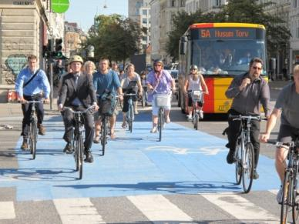
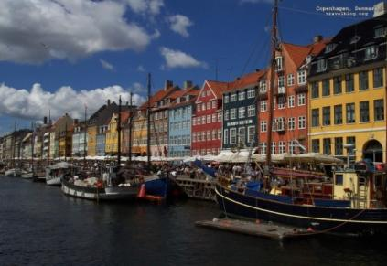
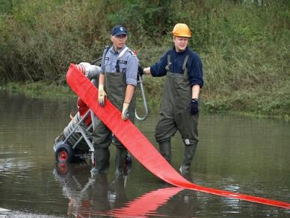
Case Study -1: Copenhagen
MITIGATION
ADAPTATION
Increased precipitation
Renewable energy
Of total energy used -13% from wind turbines
District heating – Geothermal energy
Prevent damage
Better management; technical, hard-end solutions
Larger sewers, underground basins, pumping stations
Building dykes
FOCUS AREAS
Energy efficient buildings
Energy efficient buildings
Solar cell solutions
Sea level rise
If damage is unavoidable – minimize cost of damage
Warning systems for rain
Establishing waterproof cellars
Managing rainwater
Green transport
Non-motorized transport, Hybrid vehicles, congestion charges
Integrated public transport
Warmer weather
Reduce vulnerability
Equipping cellars, Emergency preparedness
Moving of vulnerable functions to safe places
Green infrastructure
Urban greening, parks, water storages
Waste
3R’s, waste segregation, waste to energy
Source: http://kk.sites.itera.dk/apps/kk_publikationer/pdf/794_kZEjcvbgJt.pdf
http://www.kk.dk/sitecore/content/Subsites/CityOfCopenhagen/SubsiteFrontpage/LivingInCopenhagen/.ashx
Climate education
Educating children and youth
Notes:
AN INTEGRATED CLIMATE PLAN
Copenhagen’s CO2 emissions must be cut by 20% between 2005 and 2015.
Copenhagen plan is mainly a mitigation based plan.
Climate Plan to make Copenhagen a better city to live in. A city that will continue to draw attention and recognition nationally and internationally.
Climate Plan is an action plan with 50 speciﬁc initiatives.
http://www.kk.dk/sitecore/content/Subsites/CityOfCopenhagen/SubsiteFrontpage/LivingInCopenhagen/~/media/558FF07CE64041AE85437BB71D9EDF49.ashx

Slide 12
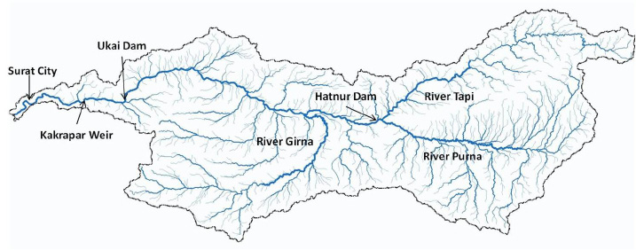
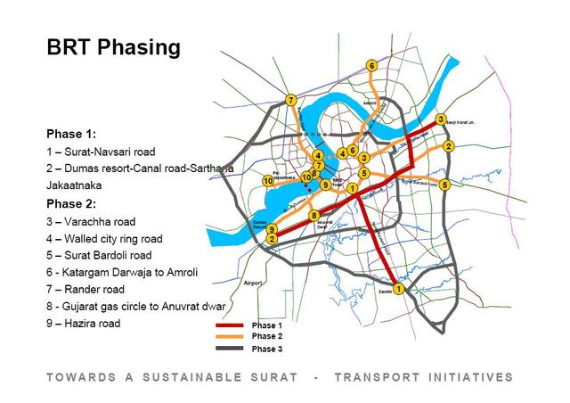
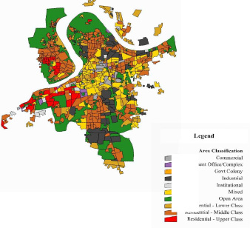
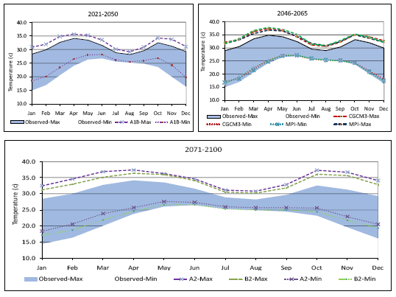
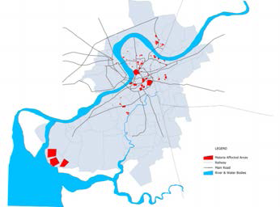
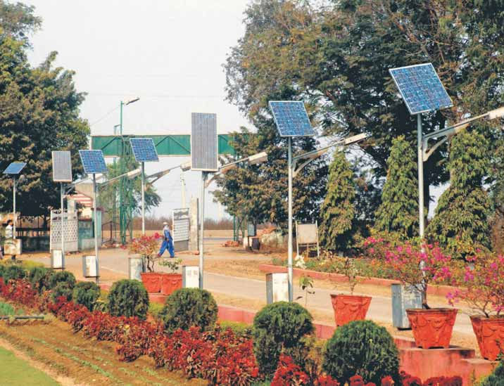
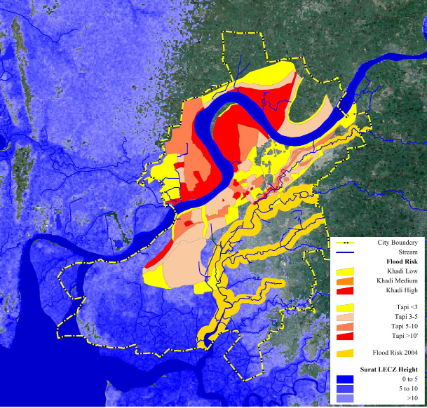
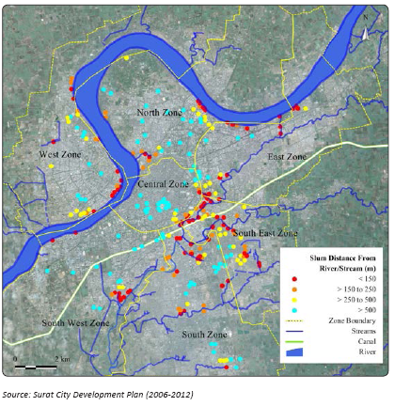
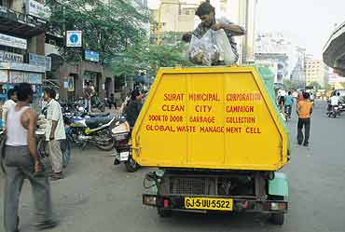
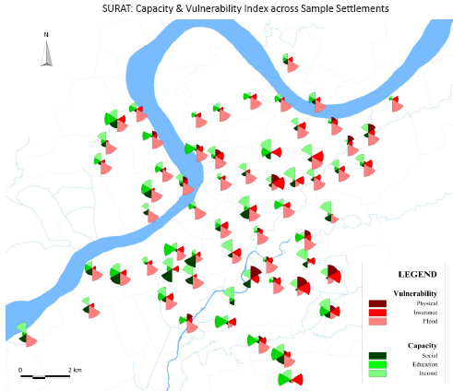
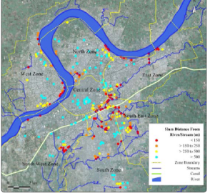
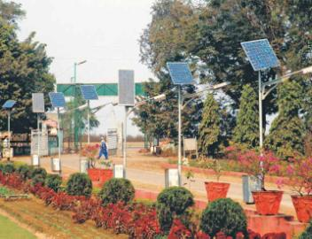
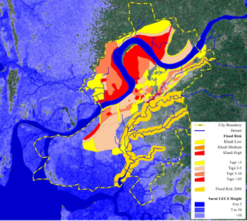
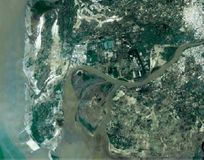
Case Study-2: Surat
PHASES
Water
Sources of water
Variability & change
Transport
Urbanization, Poverty, Climate change
Possible Impacts
Land use planning
Physical, social, Economic
Malaria affected ares
FOCUS AREAS
Flood
Evaluation & assessment
Vulnerability, capacity, constraints
Slum locations
Solid waste
Strategies
Short term, Mid term, Long term
Public health
Source:ACCRN (2011), Surat city resilience strategies, SMC
Energy
Source:ACCRN (2011), Surat city resilience strategies, SMC
Notes:
This document is prepared with the aim of providing a framework for the development of a Climate resilience strategy for the city of Surat.
Plan of surat is mainly an adaptation plan.
It has been developed through continued interactions with city stakeholders, sector studies conducted to understand different dimensions of current situation and information from secondary literature. Moreover, to gain a more analytical understanding, detailed Vulnerability
Assessment studies and a series of Risk to Resilience Workshops were conducted.
This document is aimed at city managers, while also providing information that can be understood by
people at large. Lastly, this document is based on the current situation. We would like to highlight the
need of the same being updated at regular intervals to reflect emerging trends over time. The resilience
strategies with therefore evolve over time with better understanding of climate change phenomena as
well as emerging city level issues.
http://www.acccrn.org/sites/default/files/documents/SuratCityResilienceStrategy_ACCCRN_01Apr2011_small_0.pdf

Slide 13
Sectoral Initiatives & Actions

Slide 14
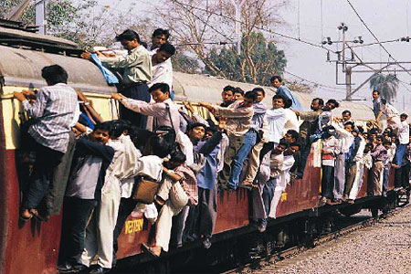
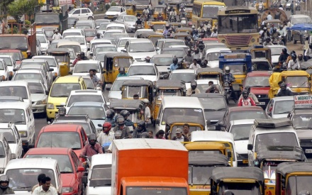
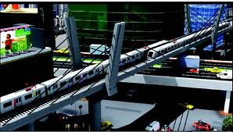
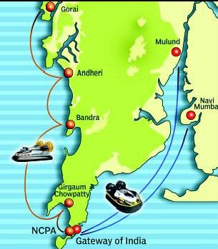
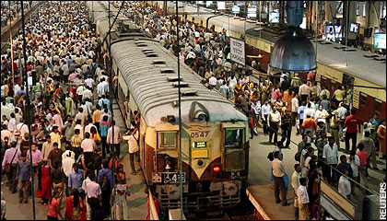
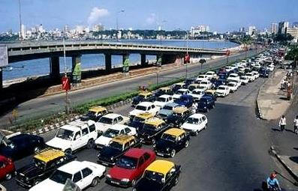
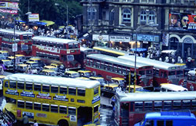
Transportation
MMR
45 million trips/day
Mumbai metro, monorail
Trip length – 14Km
Water transport
Vehicular congestion – 375/Lane/km
Target – 112/Lane/km
Railways – 500people/compartment
Target – 195people/compartment
Source:
McKinsey and Bombay first(2003), Vision Mumbai: Transforming Mumbai into a world-class city, New Delhi
Notes:
The slide explain what is the transport situation in MMR region and what should be the target.
It also mentions the type of transport facilities present in the region.
Total number of all road vehicles in the city is about 1199416 indicating that about 13% of the total vehicles in Maharshtra state ply in the city of Mumbai.
Suburban train rider ship growth is only about 80% of the population increase, but it is unable to cater to all the increase in population with Mumbai and MMR. The 137% increase in cars, a 306% increase in two wheelers, the 420% increase in autos and 128% increase in taxis during 1991-2005 has created a lethal dose of traffic congestion which has categorized Mumbai and region as one of the most congested cities in the World (TRANSFORM, 2007)
http://mumbaifirst.org/vision_mumbai/presentations/RK_MTSU-Metamor-March%204-2011.pdf

Slide 15
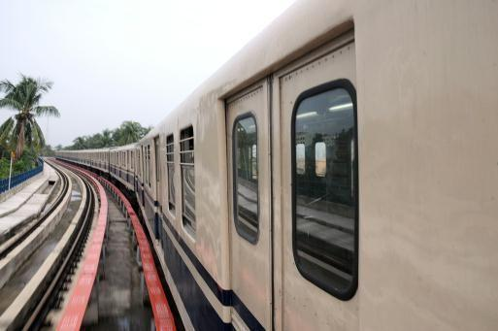
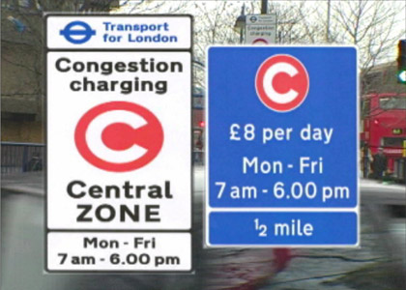
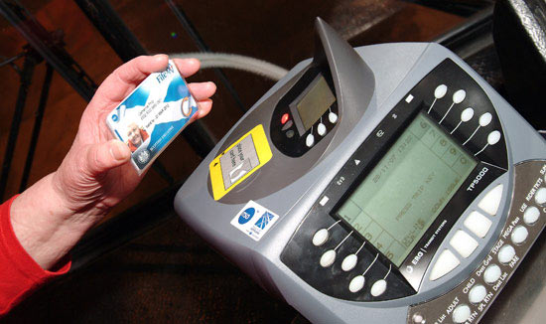
Transportation
ACTIONS
Upgradation (More comfortable, technologically advanced) of existing railway coaches¹
Kolkata
Low interest rates and subsidies on fuel efficient vehicles and hybrids²
Tokyo
Congestion tax²
London
Introduction of bio-fuel mixes³
Bangkok
Promotion of eco-driving²
Tokyo
Integrated transportation system, common ticketing²
London
Source:
¹www.thehindubusinessline.com
²GIZ (2012),Urban transport Climate Change action plans: Examples from Hamburg, London, Tokyo, FMENCNS, Berlin
³Kimble M., (2009), Bangkok Biofuels 2009, Sustainable Development of Biofuels, United Nations Foundation
Notes:
These are some initiatives which can be taken up by the MMRDA so as to solve the issues of transportation and can also help reduce ghg emissions.

Slide 16
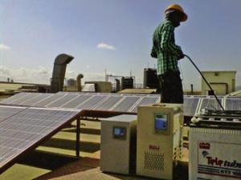
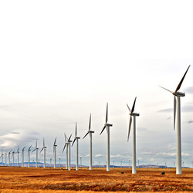
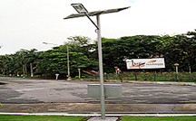
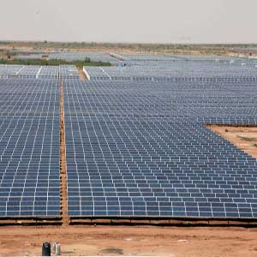
Alternate energy
MMR INTIATIVES
MMR
Solar master plan for Kalyan Dombivili Municipal corporation
Solar water heating systems (SWHS) in new buildings, municipal buildings, etc.
Rebate of 10% on SWHS installation.
Solar lighting in gardens and traffic signals.
Establishment of Solar City Cell: providing technical & financial expertise for implementation
Electricity consumption
3288MW (2011) - Mumbai
MMR
Residential demand – 1931 MW (2011)
Projection – 6680 MW (2051)
ACTIONS
Potential of solar & wind energy potential in Vidarbha & coastal areas
Centralized solar & wind power plants e.g. Gujarat
De-centralized solar initiatives at residential and commercial level
Subsidizing solar appliances and energy efficient appliances
Exploration of fuel mixes e.g. sugarcane based ethanol
Source: : http://envis.maharashtra.gov.in/envis_data/?q=eepmartcl_jun12
http://mnre.gov.in/file-manager/UserFiles/kalyan_dombivli_solar_city_master_plan.pdf
Notes:
This slide gives information about the electricity consumption in MMR.
The initiatives that have been taken in the MMR region to tap alternate energy sources.
Also mentioned are certain actions that can be taken by the authorities in near future.
The actions mentioned here have been proved working in certain other regions of the nation or in other countries.

Slide 17
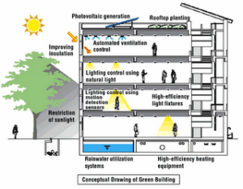
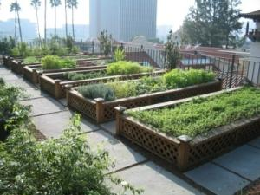
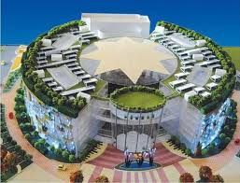
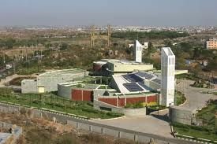
Buildings
GREEN BUILDINGS
Less use of energy, water and natural resources.
Less waste generation & healthy living conditions
Energy saving: 30% - 40% %
Potable water: 20% - 30% %
Enhanced indoor air quality, Enhanced day light & Ventilation
Source: www.igbc.in

Slide 18
Buildings
GREEN BUILDINGS
Maximum Registered Green Buildings (54/128) in India are in Mumbai
E.g.Hiranandani BG House Mumbai (Platinum rating), K Raheja group, Enercon India and Kalpataru building¹
80% of Registered Green Buildings are Commercial Buildings
ACTIONS
Need for application to Residential buildings: Townships & apartments by providing incentives
Introduction of the Concept in Development Control Regulations (DCR) & Building Permission/ Approvals from Dpt. Of Town Planning
Introduce urban agriculture, rainwater harvesting regulations
Source:¹ http://www.mumbaimania.in/2008/09/mumbai-has-20-of-green-buildings-in.html
www.igbc.in
Notes:
Green building are made so as to reduce the energy consumption by the users.
Thus this and the previous slide explain what are green buildings, presence of green buildings in MMR and the actions that can be taken by various agencies to promote them.

Slide 19
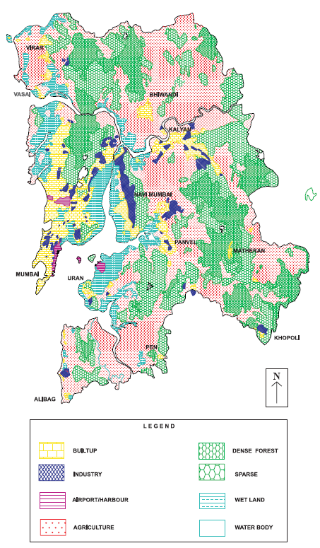
Industrial zones
Maximum no. of industries are small scale
Source: MMRDA(1999) Regional Plan for Mumbai Metropolitan Region 1996-2011, Ch.2 ‘Regional setting', Maharashtra Government Gazette, Mumbai
Notes:
This slide gives an information on what are the industrial zones in MMR, the type of industries present and their scale.

Slide 20
Reduction of GHG emissions
ACTIONS
Fuel switch
Switching to less carbon-intensive industrial fuels such as natural gas
The efficient use of biomass in steam and gas turbine
(E.g. Pulp and paper, forest products and some agricultural industries such as sugar cane)
New technologies
Use of new efficient technologies and mechanisms to reduce fuel use and time consumed to produce 1 unit of product
Cogeneration
The production of electricity using waste heat (as in steam) from an industrial process or the use of steam from electric power generation as a source of heat
E.g. coal-intensive industry has the potential to reduce its CO₂ emissions by half, without switching fuels, through cogeneration.
Process improvements
Industrial process alterations can reduce all process-related GHGs significantly or even eliminate them entirely.
Replacing natural gas as the source of industrial hydrogen with biomass hydrogen or with water electrolysis using carbon-free energy sources reduces carbon emissions in the manufacture of ammonia and replace coking coal in the production of iron
Replacing materials associated with high GHG emissions with alternatives that perform the same function
e.g., the fly-ash substitution and the use of waste fuels
Material substitution
The recycling and reuse of goods can save not only energy but GHGs released to the atmosphere
Primary materials release about four times the CO2 of secondary (recycled) materials in steel, copper, glass and paper production
Material recycling
Source: IPCC (1996), Technologies, Policies and Measures for Mitigating Climate Change, Pg 34-35
Notes:
This slide gives information on what kinds of actions and measures can be taken so as to reduce the GHG emissions by industries.

Slide 21
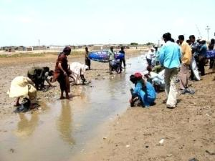
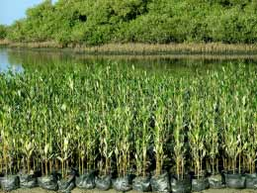
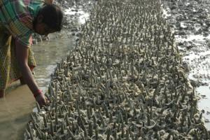
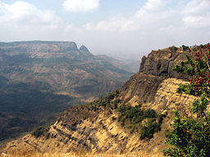
Forest & Wild Life
ACTIONS
Mangrove regeneration e.g. Gujarat
JFM in Western Ghats
Identification of 8 sites for regeneration (5000 Ha)
Restriction on housing, commercial, industrial and mining activity in forest areas
Methods – potted seedlings, earthen mound technique, direct dibbling and de-silting of natural canals
Identifying sensitive flora and fauna and taking apt measures to conserve
Implementation – community based organizations
Monitoring – NGOs
Finance - India Canada Environment Facility
Facilitator – Gujarat Ecology Commission
Creating awareness among all stakeholders
Awareness programs for cattle rearers, industries, NGOs, CBOs
Training communities to manage forests
Source: http://www.geciczmp.com/gec.aspx
http://post.jagran.com/gujarat-set-to-increase-mangrove-cover-by-120-sq-km-1314011008,
Notes:
Climate change will affect forests and the wild life dependent on it.
This slide gives the actions that have been taken by other authorities in India to protect and conserve the forests

Slide 22
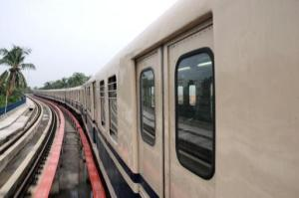
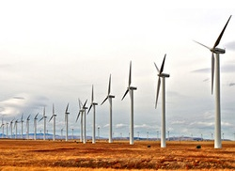
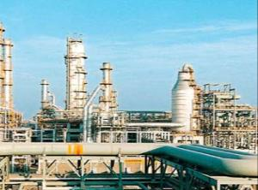
Conclusions
MMR is poised to become the fastest growing metropolitan region
It has abundant resources that cater to 21 million population, thus it is important to conserve them
Since it is an ecologically diverse region the impacts of climate change will vary in smaller parts of the region
Different agencies have to work in integration to avail the desired benefits
Climate change will have long term impacts, thus planning for future is of utmost important
All sectors can be regulated by laws, legislations and policies, thus, policy makers have an important role to play

Slide 23
The presentation is part of the series Climate Change related Resources and Tools (CCRT) developed to spread awareness on climate change and related issues as well as to facilitate actions to lessen the impact of climate change. As part of the series various other booklets, posters, factsheets, presentations, etc. have been created. The portal also has online carbon footprint calculators and a map on climate change related institutions.
To know about the other resources created under this series visit www.mmr-ccrt.org.in.
Conceived and Developed by :
Environmental Management Centre LLP for Mumbai Metropolitan Region – Environment Improvement Society

